Slide 1
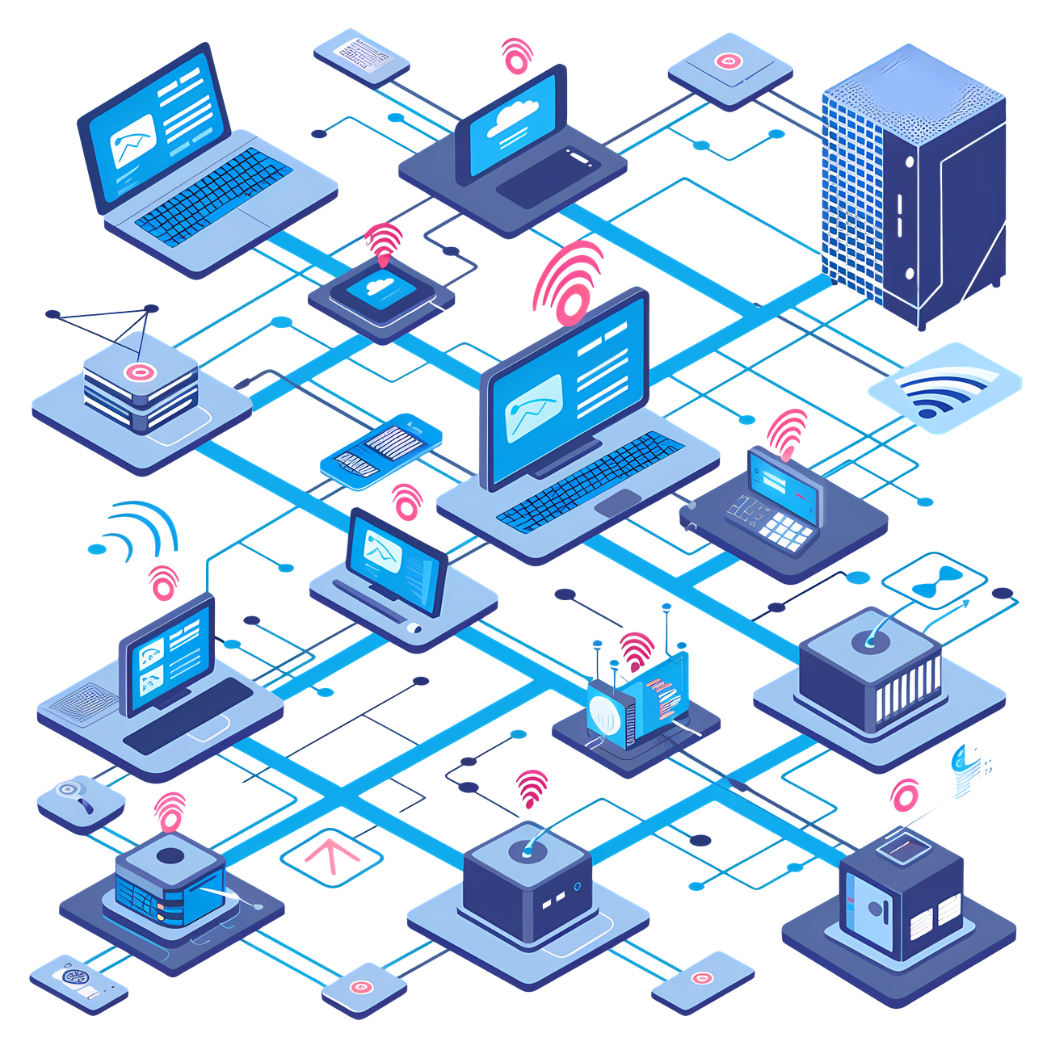
ACCESS CONTROL LIST PROJECT
PRESENTATION (PROJECT 6)
For DEPI

Slide 2
AGENDA
1.
OUR TEAM
2.
INRODUCTION
3.
NETWORK TOPOLOGY OVERVIEW
4.
ACL CONFIGURATION OVERVIEW
5.
DETAILED ACL CONFIGURATIONS (HQ ROUTER)
6.
DETAILED ACL CONFIGURATIONS (BRANCH ROUTER)
7.
CONNECTIVITY TESTS
8.
CONCLUSION

Slide 3


OUR TEAM
1.MAHMOUD SAAD
2.AHMED MOHAMED
3.ESRAA KHALIFA
4.OMAR ABDALLA
5.AHMED MAGED
6.ARWA SARAYA

Slide 4
INRODUCTION
PROJECT OVERVIEW:
This project utilized Cisco Packet Tracer to design and configure Access Control Lists (ACLs) in a virtual network environment.
Purpose:
To manage and control the flow of network traffic between different segments of a simulated organization’s network.
Key Objective:
Enhance the security of the network by preventing unauthorized access while allowing legitimate communication between network devices.
Why ACLs?:
ACLs help define rules for what traffic can enter or leave network interfaces.
They are essential for implementing security policies within an organization’s network.

Slide 5
NETWORK TOPOLOGY OVERVIEW
NETWORK DESIGN:
The network includes two primary routers:
- HQ Router: Manages communication within the headquarters
network and connects to the internet.
- Branch Router: Controls traffic at a branch office
location.
- Each router connects to multiple LAN segments, handling
traffic between the HQ, branch office, internet, and internal
devices like servers and PCs.-
COMPONENTS:
HQ Network: Two LAN segments with PCs and servers.
Branch Network: Includes PCs, a server, and internet connectivity..

Slide 6
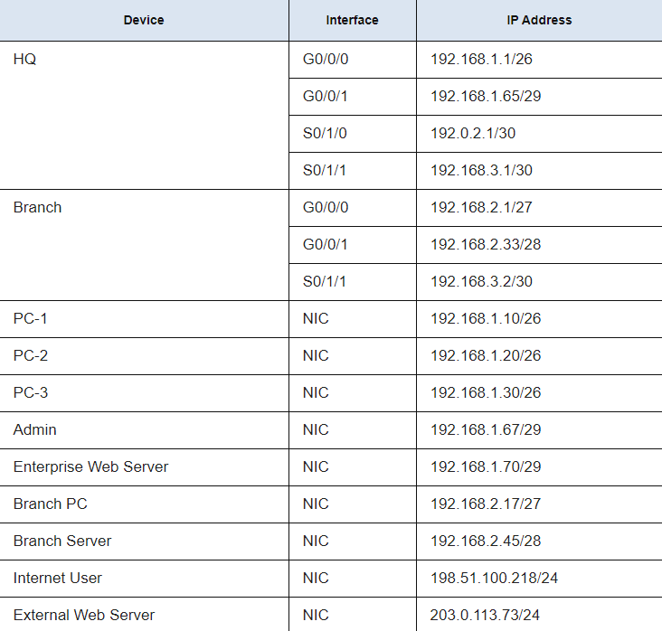
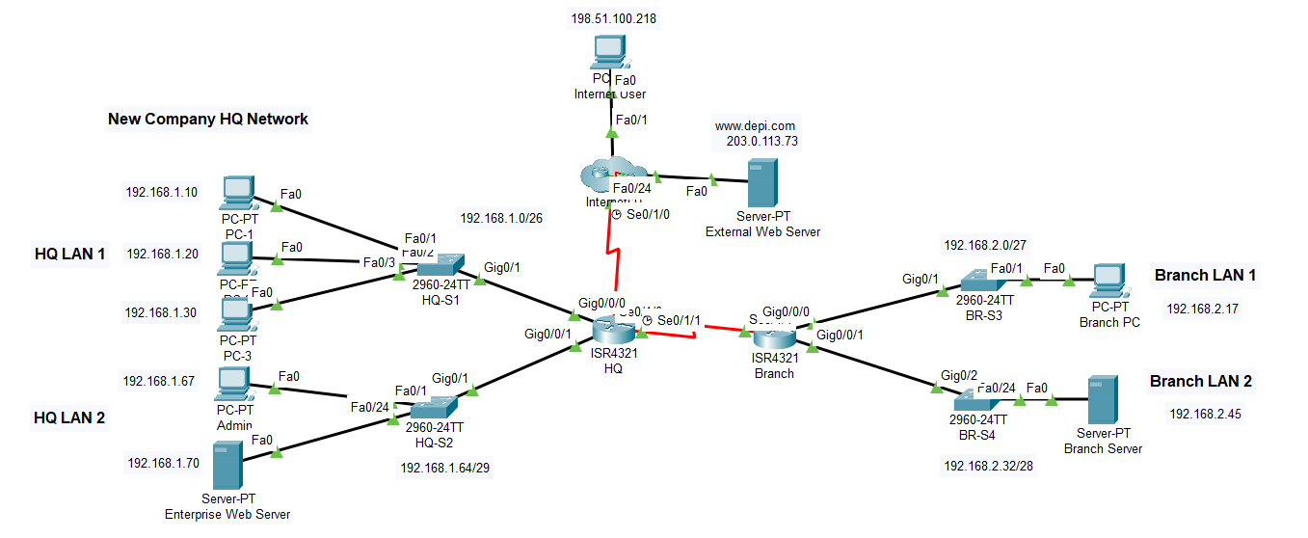

Slide 7
ACL CONFIGURATION OVERVIEW
• PURPOSE OF CONFIGURING ACLS:
- To filter incoming and outgoing traffic on specific network
interfaces.
- To restrict or allow access based on security policies for
different network segments.
- To ensure compliance with security requirements for internal
and external communication.
• Types of ACLs Configured:
- Standard Named ACLs: Used for basic filtering based on source IP
addresses.
- Extended ACLs: Provide fine-grained control over traffic by
filtering based on protocols, source, and destination IP
addresses and port numbers.
• Application of ACLs:
- ACLs were applied to specific interfaces on each router to
control the flow of traffic as it enters or exits the network.

Slide 8
DETAILED ACL CONFIGURATIONS (HQ ROUTER)
ROUTER HQ CONFIGURATIONS:
• ACL 101:
- Blocks FTP access to the Enterprise Web Server from external
users on the internet.
- Blocks FTP access from Internet User to the Branch Server.
- Denies ICMP traffic from the internet to the entire HQ LAN to
prevent ping attacks.
- Permits all other types of traffic, ensuring legitimate
communication is unaffected.
- Configuration Example:
access-list 101 deny tcp any host 192.168.1.70 eq ftp
access-list 101 deny icmp any 192.168.1.0 0.0.0.63
access-list 101 permit ip any any
ACL Application:
- Applied on the Serial0/1/1 interface to control outgoing traffic from the
branch to HQ.
interface Serial0/1/0
ip access-group 101 in

Slide 9
DETAILED ACL CONFIGURATIONS (HQ ROUTER)
ROUTER HQ CONFIGURATIONS:
• ACL 111:
- Blocks access from HQ LAN 1 to the Branch Server.
- Allows all other traffic.
- Configuration:
access-list 111 deny ip any host 192.168.2.45
access-list 111 permit ip any any
• ACL Application:
-Applied on the GigabitEthernet0/0/0 to control incoming traffic from the
HQ LAN 1.
interface GigabitEthernet0/0/0
ip access-group 111 in

Slide 10
DETAILED ACL CONFIGURATIONS (HQ ROUTER)
• STANDARD NAMED ACL (VTY_BLOCK):
- Restricts VTY (Telnet/SSH) access to the HQ router, limiting it to HQ LAN 2.
- CONFIGURATION:
ip access-list standard vty_block
permit 192.168.1.64 0.0.0.7
•ACL APPLICATION:
- Applied on the VTY lines to control incoming traffic from the
HQ LAN 2.
line vty 0 4
access-class vty_block in

Slide 11
DETAILED ACL CONFIGURATIONS (BRANCH ROUTER)
ROUTER BRANCH CONFIGURATIONS:
• EXTENDED NAMED ACL: (BRANCH_TO_HQ):
- Blocks any access attempts from Branch LAN 1 and Branch LAN 2 to HQ LAN1.
- CONFIGURATION:
ip access-list extended branch_to_hq
deny ip 192.168.2.0 0.0.0.31 192.168.1.0 0.0.0.63
deny ip 192.168.2.32 0.0.0.15 192.168.1.0 0.0.0.63
permit ip any any
• ACL APPLICATION:
- Applied on the Serial0/1/1 interface to control outgoing traffic from the
branch to HQ.
interface Serial0/1/1
ip access-group branch_to_hq out

Slide 12
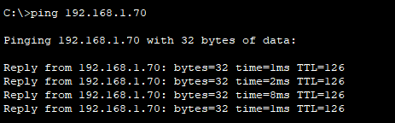
CONNECTIVITY TESTS
• PURPOSE OF TESTS: TO VERIFY THAT THE ACLS WORK AS INTENDED AND
RESTRICT OR ALLOW TRAFFIC ACCORDING TO THE CONFIGURED RULES.
• Test Scenarios:
- Test 1: Ping from Branch PC to the Enterprise Web Server.
- Result: Successful ping, as ACL 101 only blocks FTP traffic, not
ICMP or HTTP.
- Outcome: Confirms that regular traffic between the branch and
web server is allowed.

Slide 13
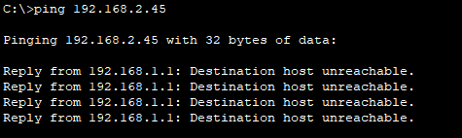
CONNECTIVITY TESTS
- Test 2: Ping from HQ PC-1 to Branch Server.
- Result: Unsuccessful ping, as ACL 111 blocks traffic to the Branch
Server.
- Outcome: Validates that HQ LAN 1 cannot access restricted branch
resources.

Slide 14
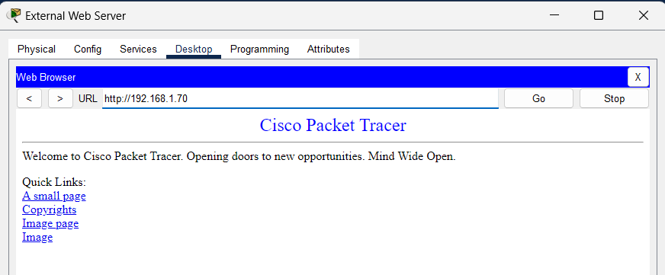
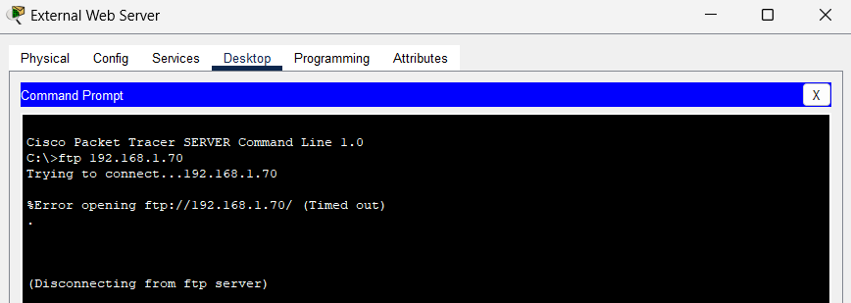
CONNECTIVITY TESTS
- Test 3: HTTP Access from External Web Server to the Enterprise
Web Server.
- Result: Access was successful, showing that ACL 101 permits HTTP
traffic while blocking FTP.
- Outcome: Confirms secure access from external sources to
internal servers.

Slide 15
CONCLUSION
• Key Takeaways:
- Successfully configured ACLs provide a layered security approach in
managing access between different network segments.
- ACLs ensured that specific traffic types (e.g., FTP and ICMP) were blocked
based on security requirements while allowing other legitimate communications.
- Validation through connectivity tests confirmed that the ACL rules were applied
correctly, securing the network.
• Future Considerations:
- Additional Adjustments: Further improvements could involve blocking unused
ports and additional protocols to enhance security.
- Regular review and updates to ACL rules are essential to adapt to evolving
security threats.

Slide 16
THANK YOU

